Slide 1
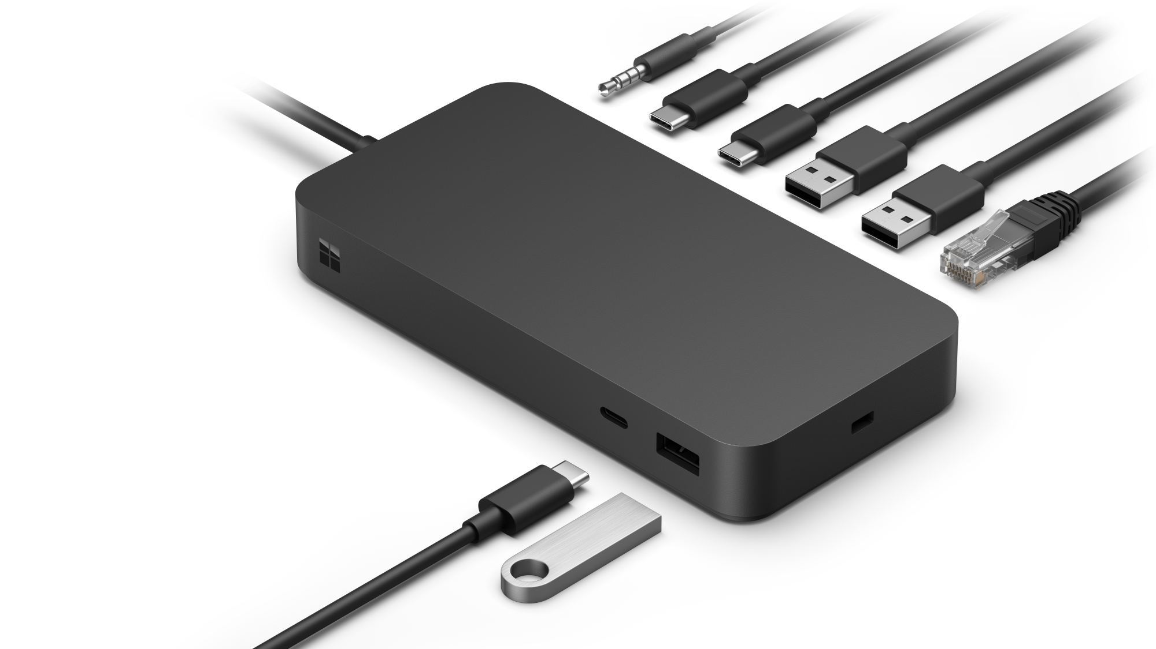
Microsoft Surface Thunderbolt™ 4 Dock
DIMENSIONS | 5.91" x 2.95" x 0.84" (150 mm x 75 mm x 21.3mm)
WEIGHT | 0.9 lb (410 g)
WHAT’S IN THE BOX | Microsoft Surface Salerno 165W Power Supply
CONNECTIONS | 165W power supply (up to 96W passthrough) Thunderbolt™ 4 Cable with LED charging indicator (80 cm) 1 front-facing USB-A (USB 3.1 Gen 2, 7.5W) 1 front-facing USB-C® (USB 4 Thunderbolt™ 4, video display enabled, 15W) 2 rear-facing USB-A (USB 3.1 Gen 2, 7.5W) 2 rear-facing USB-C® (USB 4 Thunderbolt™ 4, video display enabled, 15W) 1 Ethernet (2.5Gbit/s) 3.5 mm audio jack Security lock support (Kensington compatible) Screw nut for desk mounts Compatible with Cable Matters Desk Mount for Microsoft Surface Salerno Learn more about Design for Surface and the mount at https://learn.microsoft.com/ |en-us/surface/surface-dock-whats-new
Maximize your workspace with Surface Thunderbolt™ 4 Dock
Surface Thunderbolt™ 4 Dock delivers ultra-high speed data transfer, the versatility to connect the most important peripherals, and simplifies workspaces for ultimate productivity. Stay secure by locking down ports and restricting functionality with Surface Enterprise Management Mode for Dock.^{1,2} MAC Address Passthrough³ maintains device network identity from one dock to another for ease of management in shared workspaces.

Slide 2
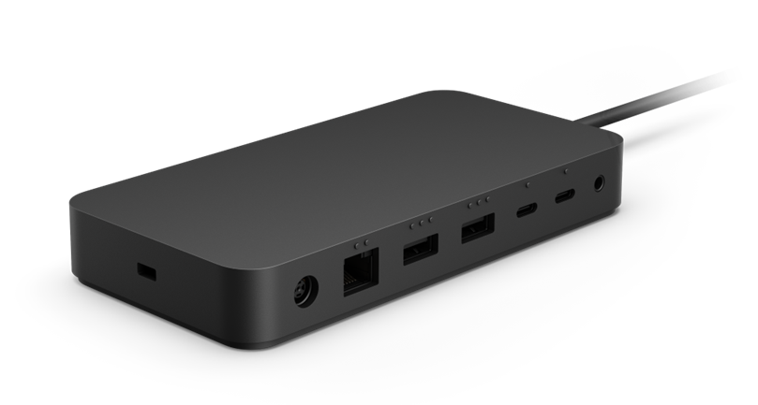
Microsoft Surface Thunderbolt™ 4 Dock
COMPATIBILITY⁴ | Designed for devices with USB-C® with USB 4.0/Thunderbolt™ 4 port: Surface Laptop 5 Surface Laptop Studio Surface Pro 8 Surface Pro 9 (Intel/Wi-Fi) Thunderbolt™ 4 connection supports two 4k external displays at up to 60hz (when supported by device and display) Compatible with devices with USB-C® port: Surface Pro 9 with 5G Surface Pro 7+ Surface Pro 7 Surface Pro X Surface Laptop 4 Surface Laptop 3 Surface Laptop Go 2 Surface Laptop Go Surface Go 3 Surface Go 2 Surface Book 3 Surface Studio 2+ (no charging) USB-C® connection supports one 4k external display at up to 60hz (when supported by device and display) Not compatible devices: Surface Duo Surface Duo 2 Surface Hub Surface Hub 2S Laptop SE
WARRANTY³ | 1-year limited hardware warranty
ACCESSIBILITY | Tactile indicators for easily identifying the ports
SUSTAINABILITY | Microsoft Surface Salerno and PSU enclosures (excluding AC cable) are attributed to 20% ocean-bound plastic Sustainable Products & Solutions | Microsoft CSR
Disclaimers
Learn more about Design for Surface and the mount at https://learn.microsoft.com/en-us/surface/surface-dock-whats-new
Surface Enterprise Management Mode for Dock and MAC address passthrough are available on select host devices and supported operating systems.
Ocean-bound plastic is plastic waste recovered from oceans and waterways, cleaned, and processed into recycled plastic resin pellets. These recycled pellets are blended in with virgin plastic during the manufacturing process

